Slide 1
Digital Portfolio
STUDENT NAME : R.Kuttikesavan
REGISTER NO :2422k2210
NMID: 26FA777A785A3779DB942C6B5C86476F
DEPARTMENT: B.sc(Computer science)
COLLEGE: Puratchi Thalavi Amma Government Arts And Science College

Slide 2
PROJECT TITLE
Digital Portfolio

Slide 3

AGENDA
Problem Statement
Project Overview
End Users
Tools and Technologies
Portfolio design and Layout
Features and Functionality
Results and Screenshots
Conclusion
Github Link
3/21/2024 Annual Review

Slide 4
PROBLEM STATEMENT
Students often struggle to present their academic achievements, skills, and projects in a structured and professional manner. Traditional resumes fail to capture creativity, practical skills, and hands-on experiences, making it difficult for students to stand out in academic or career opportunities. There is a need for a digital portfolio solution that allows students to effectively showcase their competencies, projects, and growth

Slide 5
PROJECT OVERVIEW
By developing this portfolio system, students will have a personalized digital identity that goes beyond a traditional CV, enhancing their chances of securing opportunities in competitive environments. It will also provide academic institutions and recruiters with a reliable and holistic view of a student’s potential

Slide 6

WHO ARE THE END USERS?
Primary End Users: Students
Secondary End Users: Employers, recruiters, faculty, mentors, admission officers

Slide 7
TOOLS AND TECHNIQUES
Tools: Programming languages, frameworks, databases, design software, deployment platforms.
Techniques: Requirement analysis, agile methodology, UI/UX design, responsive design, testing.

Slide 8
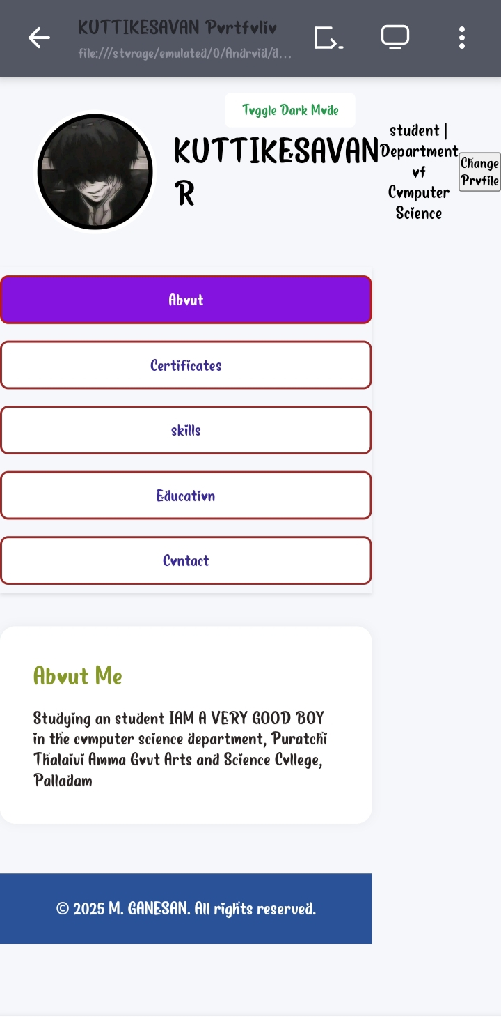
POTFOLIO DESIGN AND LAYOUT
A well-designed portfolio layout ensures clarity, professionalism, and impact while making it easy for recruiters and mentors to quickly assess a student’s strengths.
8

Slide 9
FEATURES AND FUNCTIONALITY
Features = What’s inside (profile, skills, projects, achievements, etc.).
Functionalities = What users can do (create, edit, share, export, search).

Slide 10
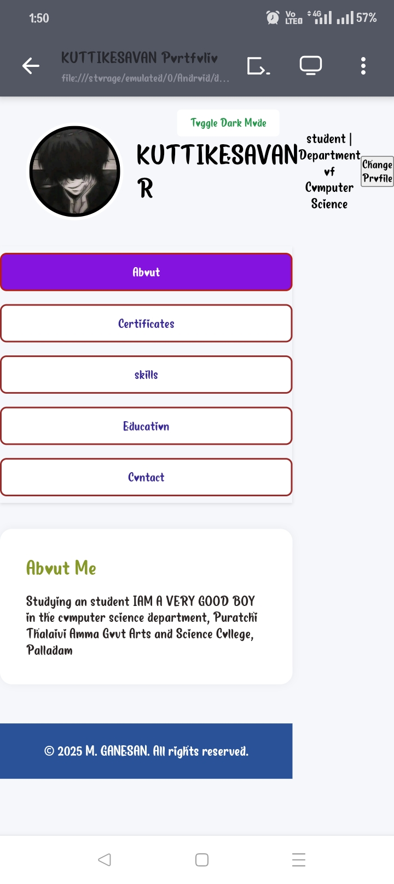
RESULTS AND SCREENSHOTS
3/21/2024 Annual Review
10

Slide 11
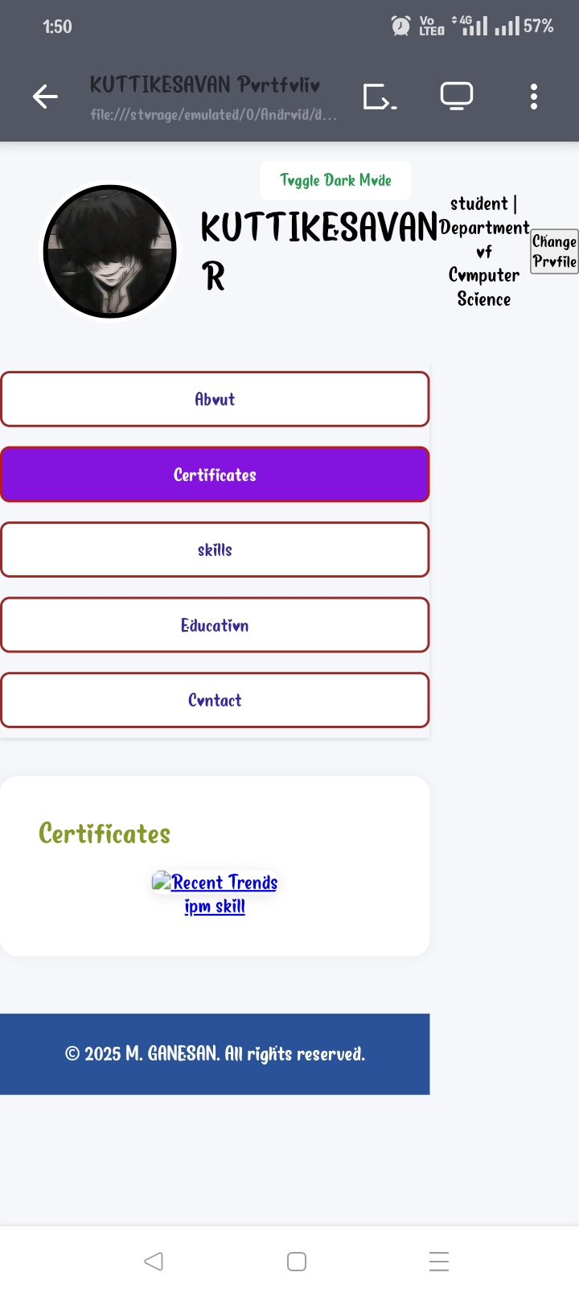
About Me
I am studying in the computer science department, Puratchi Thalaivi Amma Govt Arts and Science College, Palladam
Certificates

Slide 12
Education
SSLC:GBHSS valasaiyur- selam
Plus Two: GBHSS valasaiyur- selam
BSC CS: PTA GASC Palladam
Skills
•C program
•Python
•C++ program
•Java
•Web Development
•JavaScript

Slide 13
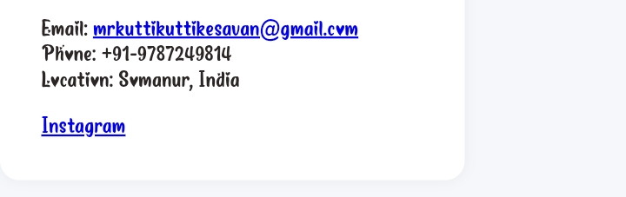
contact

Slide 14
CONCLUSION
The development of the portfolio project successfully achieved its goal of creating a professional. user-friendly, and visually appealing platform to showcase skills, projects, and experiences. The responsive design ensures accessibility across various devices, while the integration of multimedia elements and third-party links enhances the portfolio's effectiveness and reach.
14

